Slide 2

Social Publishing System
Χαράλαμπος Χαραλάμπους
Πασχάλης Μπέης
Δημήτρης Χριστοφή
Καθηγητής : Μάριος Δικαιάκος
Λευκωσία, Μάιος 2013

Slide 3

Social publishing
Social publishing unites audiences and builds communities around great content.
Blend of three categories
- Web Content Management
-Social Software (blogs, wikis, social networking platforms, forums, etc.)
-Web application frameworks

Slide 4
The concept of our project
A social publishing system independent from other social networks
Encourage users to add their personal journals
Offer a user friendly environment and smart design
A website adapted to new technologies and new marketing needs

Slide 5


PHP (Hypertext Preprocessor)
Server scripting language
Powerful tool for making dynamic and interactive Web pages
Can edit files on the server (create, open, read, write, close)
Add, delete, modify data in DB
Runs on different platforms
Support a wide range of DBs
Data encryption
Notes:
PHP scripts are executed on the server

Slide 6


HTML & CSS
Hypertext Markup Language (HTML)
The main markup language for creating websites
Written in the form of HTML elements consisting of tags enclosed in angle brackets
Browsers read HTML docs & compose them into visible or audible web pages
Cascading Style Sheets (CSS)
Style sheet language
Simple mechanism for adding style to Web documents
Style (e.g. fonts, colors, spacing)

Slide 7


MySQL
jQuery
MySQL + PHP, you can connect to and manipulate databases
The most popular database system used with PHP
Database system used on Web
Runs on a server
Very fast, reliable, easy to use
Supports standard SQL
Compiles on the most platforms
JavaScript Library
Greatly simplifies JS Programming
Easy to learn
Lightweight (“write less, do more”)
More than 55% of 10 000 most visited websites use it.

Slide 8


Twitter Bootstrap
Twitter Bootstrap
Collection of tools for creating websites and web applications
Contains HTML and CSS-based design templates
Most popular project in GitHub

Slide 9


JSON
AJAX
JavaScript Object Notation
Syntax for storing & exchanging text information (like XML)
Smaller than XML, and faster and easier to parse
Self-descriping
Hierarchical
JSON data can be transported using AJAX
Asynchronous JavaScript & XML
NOT a new programming language
But a new way to use existing standards
The art of exchanging data with a server, and updating parts of a webpage, without reloading the whole page
Used by:
Google Maps, Gmail, YouTube, Facebook tabs.

Slide 10
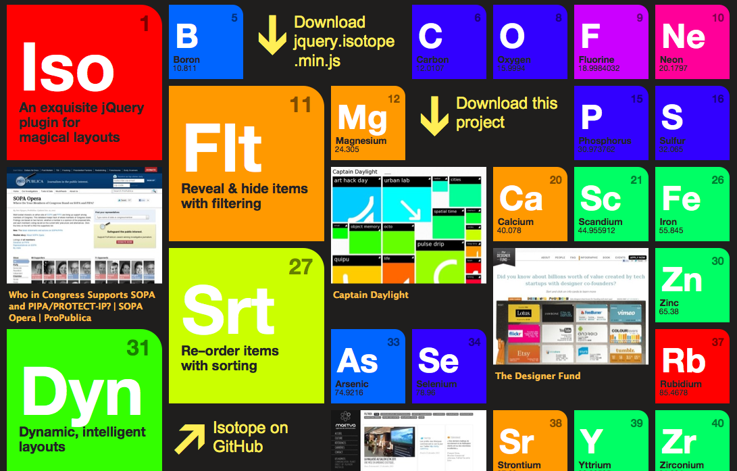

JavaScript
Isotope
Interpreted computer programming language
Prototype-based scripting language
It’s dynamic, weakly typed and has first-class functions
Website usage
-load new page content via AJAX
-animation of page elements
-interactive content
-validating input of web forms
Dynamic Layouts
Intellligent, dynamic layouts
Filtering
Hide & Reveal elements easily
JQuery selectors
Sorting
Re-order item elements with sorting

Slide 11

Project Name : SocioPub
Social Publishing website
Users can post their own content, either articles from other websites they liked and they want to share or their personal journals
Every article is shown as an abstract of the original one
Users connect to other users sharing their content

Slide 12
Main features
Article’s value can be measured in multiple ways(likes , shares , views)
Articles can be aligned in many ways(chronological order , device resolution and size , auto-alignment when window size changes)
Content filtering according to categories , sources and other measures
Search ability using any preferred keywords

Slide 13
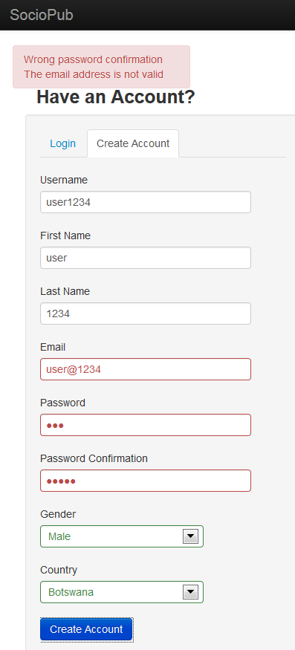
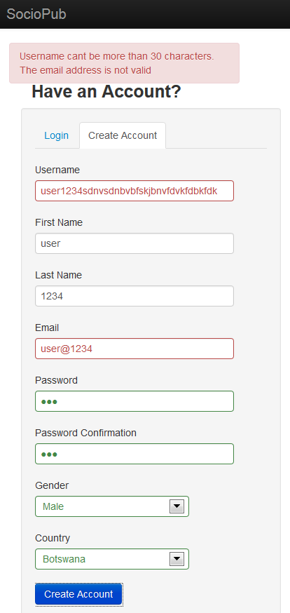
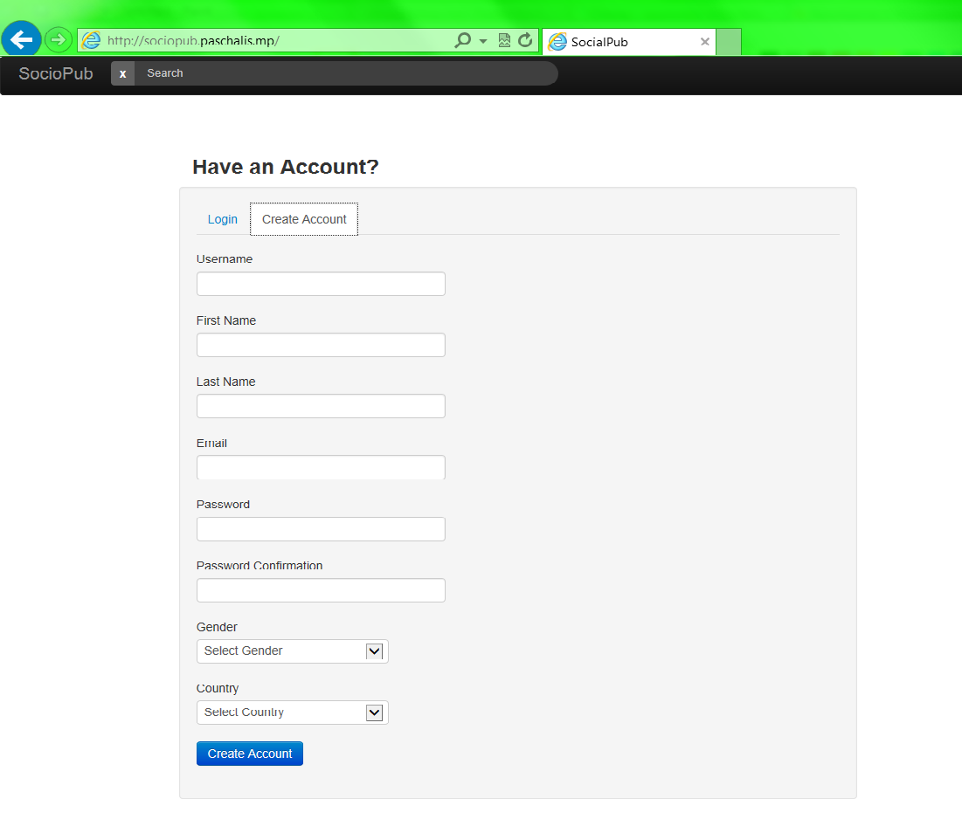
Create Account
ERRORS
Συμπλήρωση της φόρμας για δημιουργία λογαριασμού

Slide 14
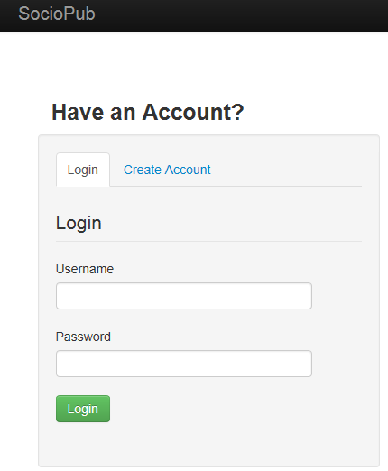
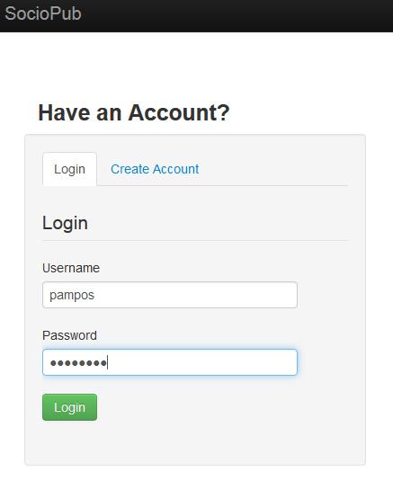
Login

Slide 15
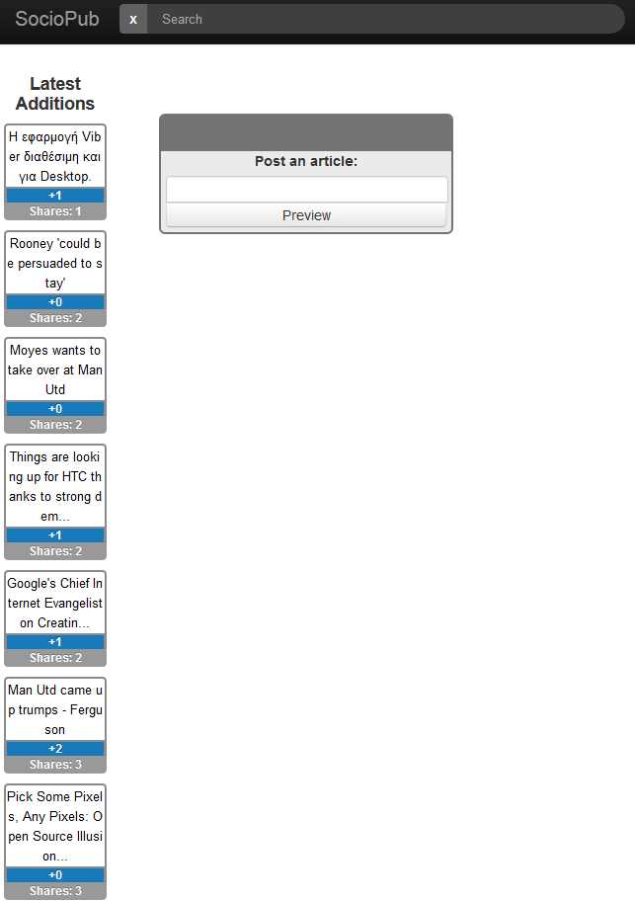
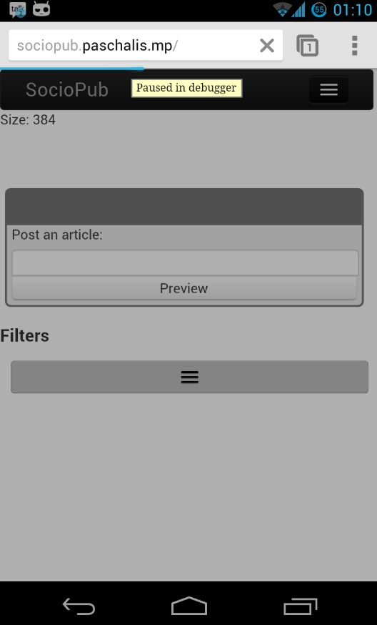
First time login
No articles yet
Latest articles of other users on the left
Post an article windows

Slide 16
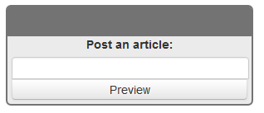
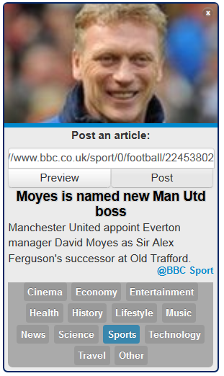
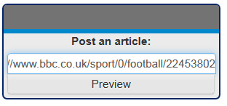
Post an article

Slide 17
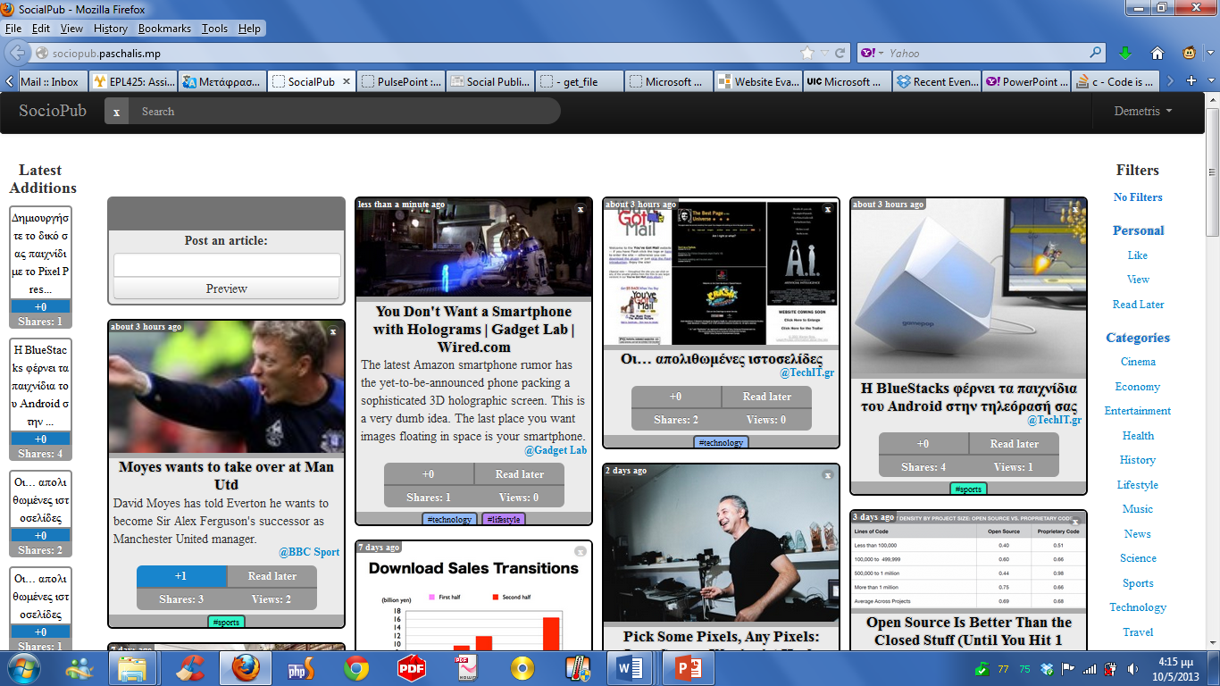
Alignment

Slide 18
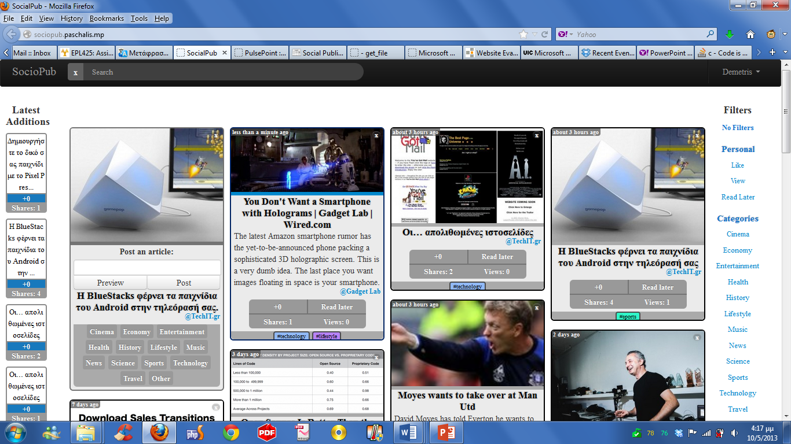
Sharing

Slide 19

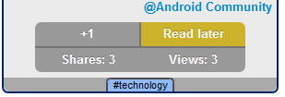
Article features

Slide 20
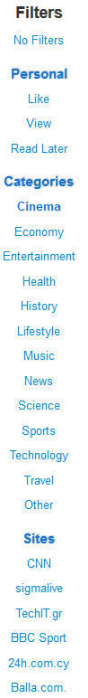
Filters

Slide 21
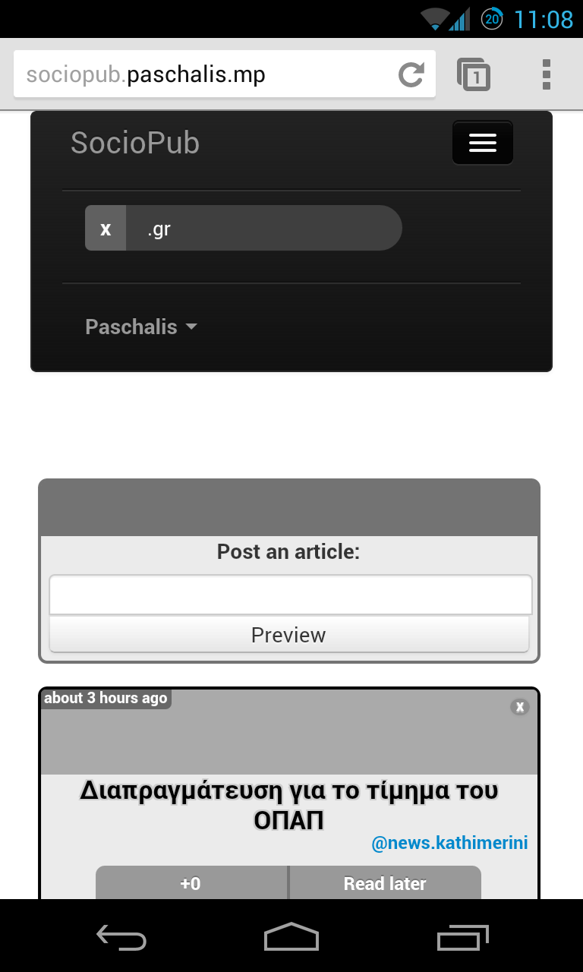
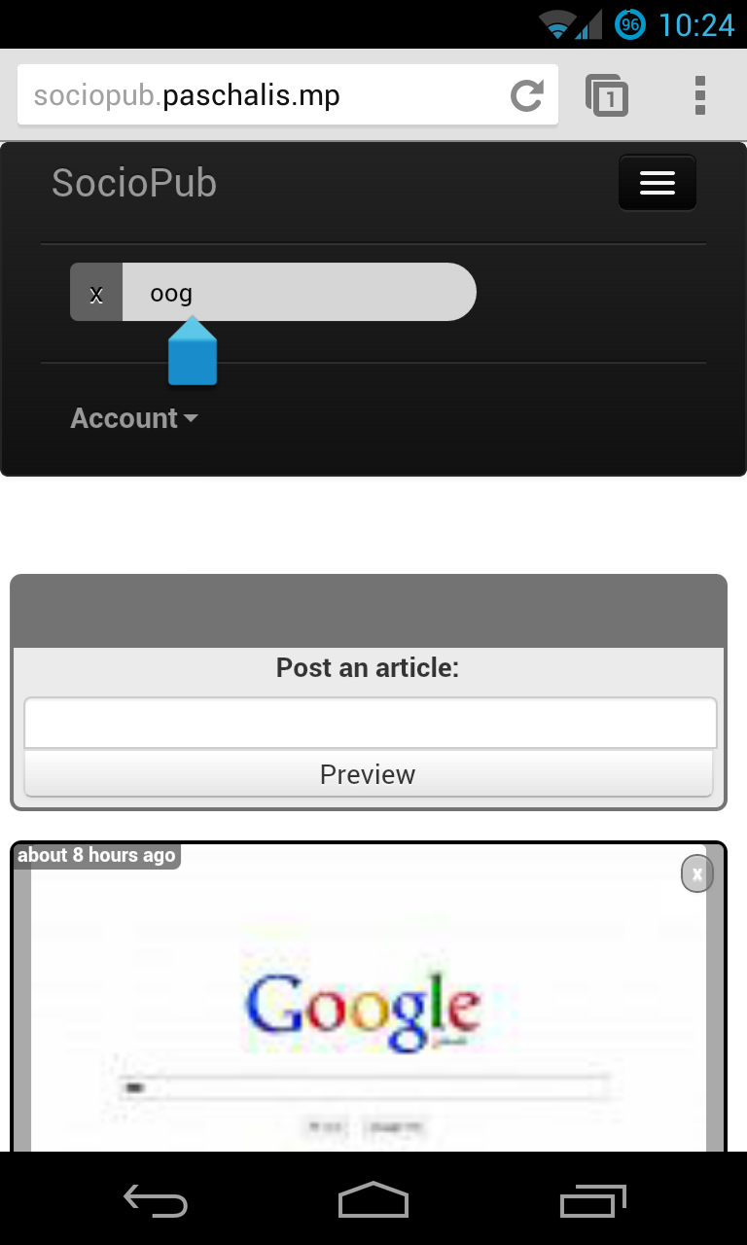
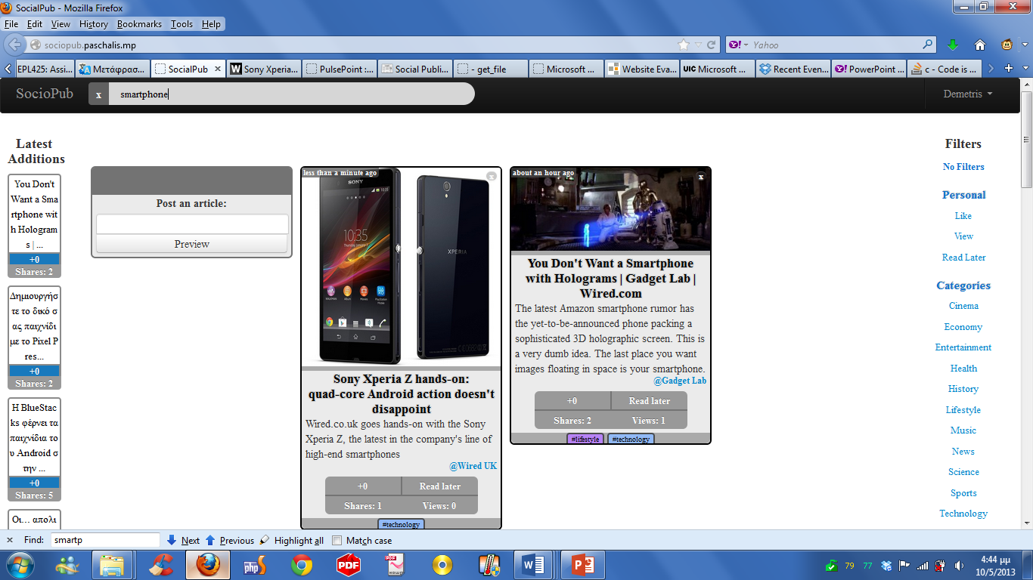
Search
Mobile

Slide 22
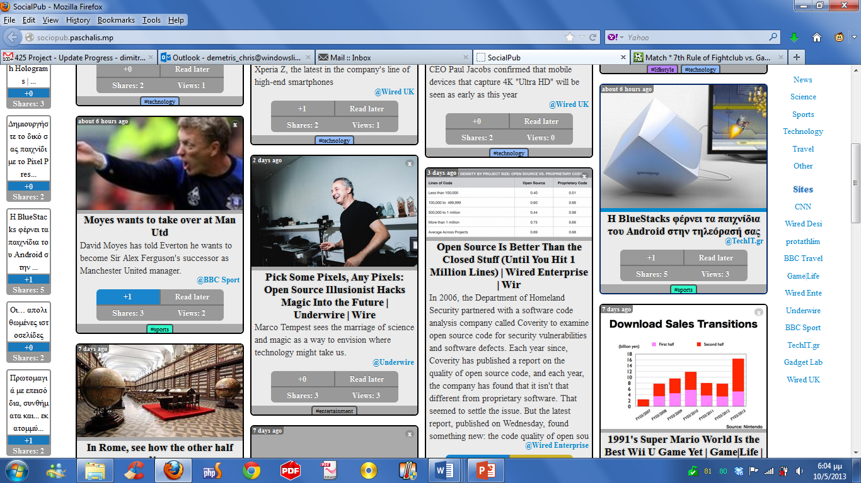
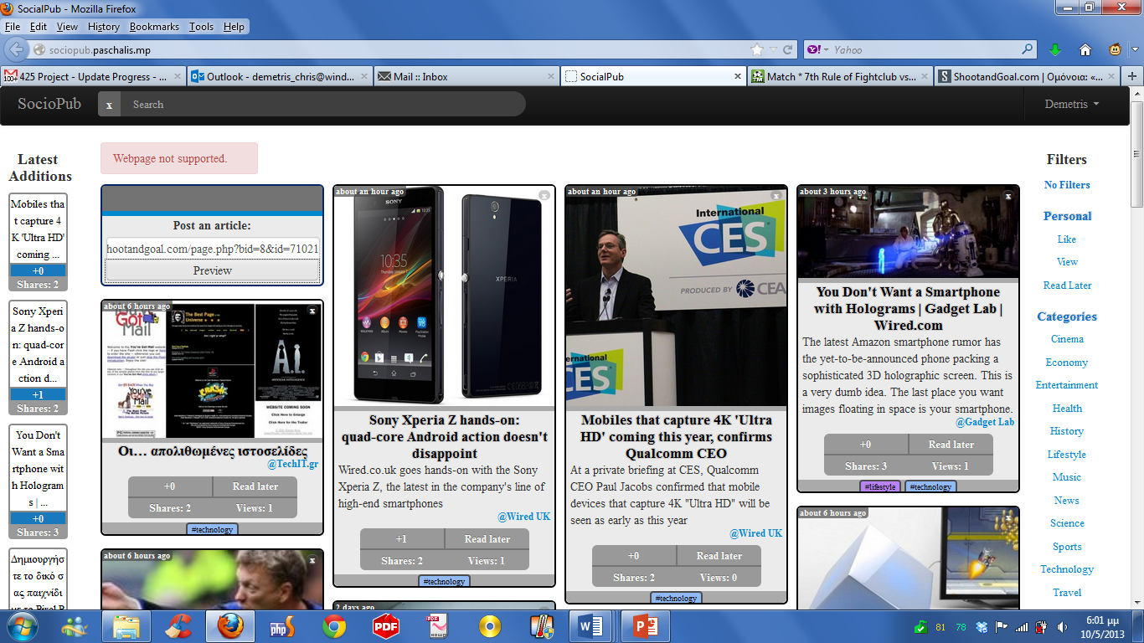
Article manipulation

Slide 23
Conclusions
Fully functional website ready for official use
Modern design adjusted to new technologies
Future extensions
Social network buttons ( Facebook like , google plus +1, retweet)
Connect with other users for better communication (messages , chat , forum)
Help , about , settings features

Slide 24
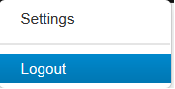
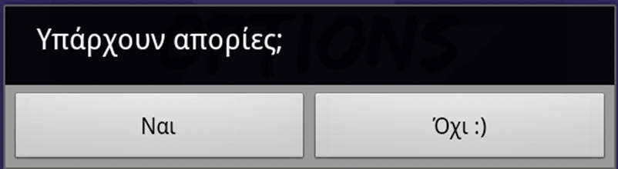

Any Questions

